Slide 1
A NOVEL IMAGE QUALITY ENHANCEMENT TECHNIQUE FOR IMPROVING THE QUALITY OF AN IMAGE
Name : Palash Khandelwal
Registration No : 22MCA1129
Guide Name – Dr. S Rajkumar
School of Computer Science and Engineering
VIT Chennai

Slide 2
Answers to the previous review questions
Q1) What is the domain you are focusing on?
Ans) I am focusing on satellite images that contains corruptions.
Q2) Removing impulse noise is an old technique nowadays everybody does that
Ans) There are many works carrying out in impulse noise and still the research is going on in impulse noise treatment. Proof is attached here
Q3) Plot for the definition of image noises as the proof
Ans) I have plotted Histogram of the images that contains corruptions.

Slide 3
Problem Statement
To enhance the quality of the satellite image which is affected by
Gaussian noise
Impulse noise
To assess the performance of the proposed image enhancement algorithms

Slide 4
Literature surveys

Slide 5
RESEARCH PAPER | FINDINGS
S. Rajkumar, G. Malathi, "An efficient image denoising approach for the recovery of impulse noise," | The paper presents the results of applying the proposed HINR filter to a color image with impulse noise. Traditional filters like order statics filters and rank order rank selection filters were inadequate for removing impulse noise. The HINR filter is designed to identify and handle high-density impulse noise in color images while preserving fine details, such as edges.
C. Thomasi, R. Manduchi, "Optimization of bilateral filter parameters using a whale optimization algorithm," | smooths images while preserving edges, by means of a nonlinear combination of nearby image values. the method is noniterative, local, and simple. The research paper appears to focus on a novel approach to image denoising and restoration using a combination of the bilateral filter and the whale optimization algorithm
Qiaoyi Liang, Runwen Hu and Shijun Xiang∗ " Invertible color-to-grayscale conversion by using clustering and reversible watermarking " | Color palette generation Grayscale image generation Reversible embedding Grayscale-to-color reconstruction
Demudunaidu ch , James Stephen m , Pallam Setty s , Praveen babu choppala 4 "A survey of impulse noise reduction methods in digital images ," | The paper specifically focuses on impulse noise, characterized by sudden, unexpected variations in pixel values. To address this issue, the paper evaluates and compares the performance of various median-based filter versions for noise reduction in color images. Quality evaluation metrics like mean square error (MSE), peak signal to noise ratio (PSNR), and structural similarity index measure (SSIM) are used to assess the effectiveness of these filters.
Jianbin Xiong , Dezheng Yu , qi wang , Lei Shu, Jian Cn , Qiong Liang, 5 Huanyang Chen, and Baocheng Sun “Application of histogram equalization for image enhancement in corrosion areas" | The paper describes a series of image enhancement techniques and processes, such as histogram equalization, dark detail enhancement, wavelet adaptive adjustment which are combined to enhance the brightness component of metal corrosion images.

Slide 6
RESEARCH PAPER | FINDINGS
Bhaskar Jyoti Borah, and Chi-kuang Sun “A GPU-Accelerated Modified Unsharp-Masking Method for High-Frequency Background- Noise Suppression” | The core of the proposed method is a modified unsharp masking(UM) algorithm. This modified unsharp masking algorithm aims to suppress high-frequency noise while preserving the original image's resolution and useful information
Snežana Puzović, Ranko Petrović, Miloš Pavlović, Srđan Stanković “Enhancement Algorithms for Low-Light and Low- Contrast Images” | The main objective of the paper is to address the challenges faced by long-range surveillance systems when capturing and processing images and videos under adverse conditions, such as low-light environments and atmospheric disturbances like haze, fog, and low visibility. The paper also mentions additional image enhancement techniques such as contrast adjustment, median filtering, and image sharpening, which can be used alongside dehazing to further improve image quality
Zhixiang Duan, Guangxin Li1, Guoliang Fan " An effective sharpness assessment method for shallow depth-of-field images ” | This paper proposes a no-reference objective sharpness assessment algorithm based on block energy differences, addressing the sharpness of shallow depth-of-field images. This innovative approach is applied to a dataset created for assessment, demonstrating its accuracy and universality compared to other algorithms.
Sergei Yelmanov, Yuriy Romanyshyn " A New Approach to Image Enhancement by Non-Linear Contrast Stretching ” | The paper discusses image denoising, a crucial pre-processing task to enhance image quality, particularly focusing on the removal of salt-and-pepper noise (SPN) and an improved approach called the "improved adaptive weighted mean filter (IAWMF)" to address the limitations of existing filters. IAWMF assigns new pixel values based on weighted means and Euclidean pixel similarity, effectively reducing artifacts, preserving image details, and smoothening edges
Vedant Gupta, Srikumar Sastry, Suman K. Mitra " Hyperspectral Image Classification using Trilateral Filter and Deep Learning," | By leveraging the trilateral filter, the paper effectively addresses the limitations associated with traditional bilateral filters, ensuring that sharp gradients and high-gradient regions are properly preserved

Slide 7
Research Objectives identified(HINR)
Objective 1: Algorithm Development
Develop and implement a modified Hybrid Impulse Noise Removal (HINR) filter algorithm that incorporates a bilateral filter and weighted averaging for improved impulse noise removal in color images.
Objective 2: Noise Removal and Edge Preservation
Evaluate the effectiveness of the modified algorithm in removing impulse noise while preserving fine details and edges in color images.
Objective 3: Smoothing Effect Reduction
Quantify and compare the reduction in smoothing effects achieved by the modified algorithm compared to traditional noise removal techniques.
Objective 4: Real-World Applications
Assess the applicability of the modified HINR filter algorithm to real-world scenarios, such as medical imaging, surveillance, and remote sensing, by testing it on diverse image datasets.

Slide 8
RESEARCH OBJECTIVES IDENTIFIED(AGD)
Objective 1: algorithm development and implementation
Develop and implement an adaptive gaussian denoising algorithm.
Objective 2: performance evaluation
Evaluate the performance of the adaptive gaussian denoising algorithm.
Define metrics to quantitatively measure the reduction in noise achieved by the algorithm.
Assess the overall image quality after denoising.
Objective 3: edge preservation analysis
Investigate the algorithm's ability to preserve edges and fine details.
Establish metrics for quantifying the preservation of edges.
Compare the algorithm's edge preservation against traditional denoising methods.
Objective 4: parameter sensitivity and fine-tuning
Examine the sensitivity of the algorithm to different parameters and fine-tune them for optimal performance.
Evaluate the impact of key parameters on algorithm performance.
Fine-tune parameters to achieve the best balance between noise reduction and edge preservation.

Slide 9
Proposed solution to the problem
Modified hybrid impulse noise removal (HINR) filter algorithm
step 1: grayscale conversion
Convert the input RGB image into grayscale using the formula grayscale = r * 0.21 + g * 0.72 + b * 0.01.
step 2: improved noise removal
For each 3x3 neighborhood centered at pixel (x, y) in the grayscale image:
if f(x, y) < 255, retain all 8 neighboring pixels.
if f(x, y) == 255, apply the following conditions:
condition-1: if specific neighboring pixels are also 255, compute a weighted average using the given relation and replace the center pixel with the result.
condition-2: compute a weighted average for non-255 neighboring pixels and replace the center pixel with the result.
step 3: bilateral filter for edge preservation
Apply a bilateral filter to the output image obtained from step 2. the bilateral filter considers both spatial proximity and pixel intensity similarity when smoothing an image. it selectively smooths regions of the image while preserving edges and fine details.
step 4: edge enhancement
Subtract the blurred image obtained in step 3 from the image obtained in step 2. this step extracts enhanced edge information.
step 5: final sharpening
Add the image obtained in step 4 to the image obtained in step 2. this final step eliminates the remaining smoothing effects in the filtered image, resulting in a sharpened image that effectively removes impulse noise while preserving edges and fine details.
The proposed solution enhances the original HINR filter algorithm by introducing the bilateral filter in step 3, which significantly improves edge preservation and reduces unwanted smoothing effects. additionally, the weighted averaging in step 2 allows for adaptive noise removal while maintaining image details. this modified algorithm is designed to address the challenges posed by impulse noise removal in color images while enhancing overall image quality. researchers can now implement and evaluate this algorithm based on the defined research objectives to assess its effectiveness and applicability in various scenarios.

Slide 10
PROPOSED SOLUTION to the problem
Adaptive gaussian denoising (AGD) filter algorithm:
Step 1: load and convert the image
Load the image and convert it to grayscale.
Step 2: define neighborhood and initialize denoised image
Define the size of the local neighborhood and create an empty array for the denoised image.
Step 3: iterate over image pixels
Iterate over the image pixels to perform adaptive gaussian denoising.
Step 4: display and save results
Display the original and denoised images and save the denoised image to a file.

Slide 11
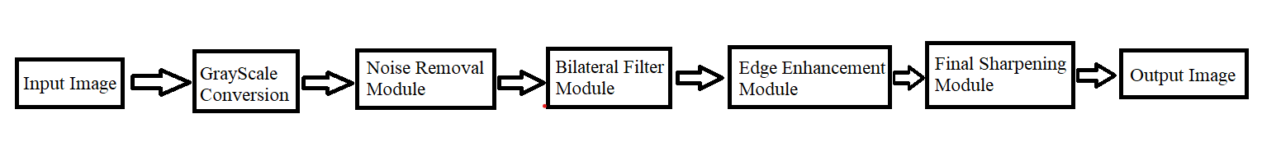
Architecture Diagram of Hybrid impulsive noise removal algorithm (HINR)

Slide 12
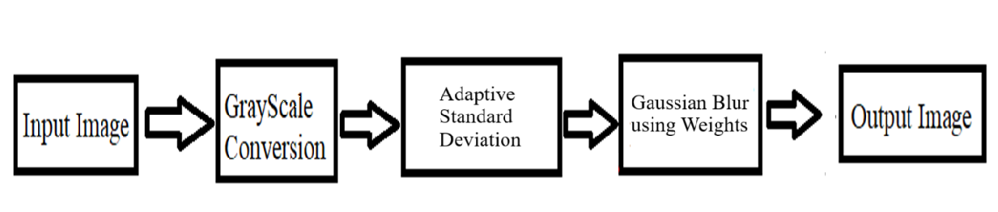
Architecture Diagram of Adaptive gaussian denoising algorithm (agd )

Slide 13
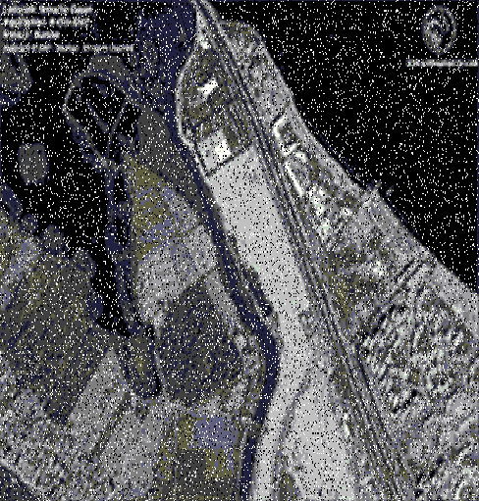
Datasets used
1. Impulsive Noise:
Figure 1.a)
Height: 511 px width: 488 px
Source- https://www.google.com/url?sa=t&rct=j&q=&esrc=s&source=web&cd=&ved=2ahUKEwirzu7ru8CCAxXtUWwGHZE5AQoQFnoECAgQAw&url=https%3A%2F%2Fwww.ijert.org%2Fresearch%2Fremoval-of-salt-and-pepper-noise-from-satellite-images-IJERTV2IS110634.pdf&usg=AOvVaw0tTVMTn3Y5VZ7upSQO3E9b&opi=89978449

Slide 14
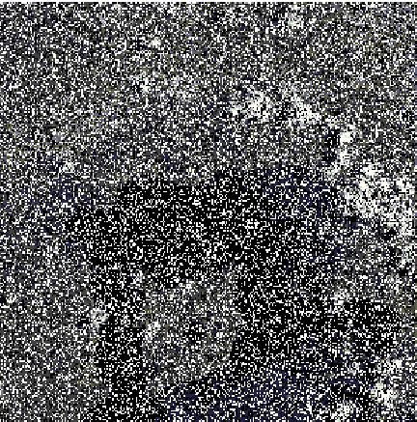
Datasets used(cont.)
Figure 1.b)
Height: 437 px width: 432 px
Source- https://www.google.com/url?sa=t&rct=j&q=&esrc=s&source=web&cd=&ved=2ahUKEwirzu7ru8CCAxXtUWwGHZE5AQoQFnoECAgQAw&url=https%3A%2F%2Fwww.ijert.org%2Fresearch%2Fremoval-of-salt-and-pepper-noise-from-satellite-images-IJERTV2IS110634.pdf&usg=AOvVaw0tTVMTn3Y5VZ7upSQO3E9b&opi=89978449

Slide 15
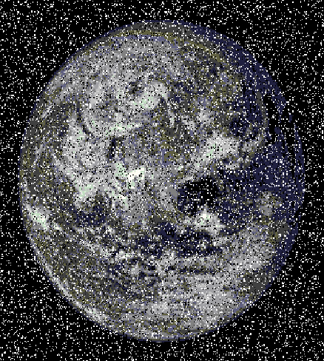
Datasets used(cont.)
Figure 1.c)
Height: 488 px width: 438 px
Source- https://www.google.com/url?sa=t&rct=j&q=&esrc=s&source=web&cd=&ved=2ahUKEwirzu7ru8CCAxXtUWwGHZE5AQoQFnoECAgQAw&url=https%3A%2F%2Fwww.ijert.org%2Fresearch%2Fremoval-of-salt-and-pepper-noise-from-satellite-images-IJERTV2IS110634.pdf&usg=AOvVaw0tTVMTn3Y5VZ7upSQO3E9b&opi=89978449

Slide 16
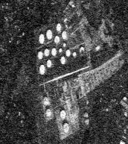
datasets used(cont.)
2. Gaussian Noise:
Figure 2.a)
Height: 193 px width: 172 px
Source- https://www.researchgate.net/figure/median-filter-to-remove-gaussian-noise_fig1_318502666

Slide 17
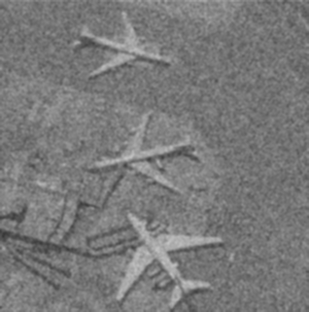
datasets used(cont.)
2. Gaussian Noise:
Figure 2.b)
Height: 321 px width: 318 px

Slide 18
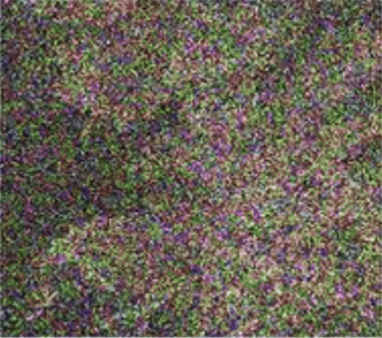
datasets used(cont.)
2. Gaussian Noise:
Figure 2.c)
Height: 270 px width: 302 px
Source- https://www.researchgate.net/figure/twenty-three-satellite-images-with-added-noise-in-different-peak-signal-to-noise-ratios_fig1_326356037

Slide 19
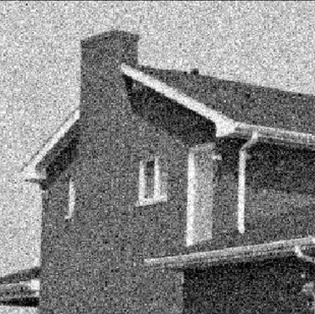
datasets used(cont.)
2. Gaussian Noise:
Figure 2.d)
Height: 428 px width: 430 px
Source- https://www.researchgate.net/figure/a-real-image-of-size-128128-pixels-without-noise-b-noisy-image-with-a-gaussian_fig2_41013989

Slide 20
Modules Identified
Input module:
Responsible for loading the input color image.
Grayscale conversion module (step 1):
Converts the input color image to grayscale using the specified relation.
Impulse noise removal module (step 2):
Implements the modified step 2 to remove impulse noise, including parameter fine-tuning and weighted averaging.
Edge-preserving filter module (step 3):
Applies the bilateral filter to enhance edges and reduce smoothing artifacts.
Image enhancement module (step 4):
Subtracts the blurred image (from step 3) from the output of step 2 to extract enhanced edge information.
Sharpening filter module (step 5):
Applies the sharpening filter with parameter fine-tuning to eliminate the smoothing effect and enhance edges.
Output module (step 6):
Presents the final sharpened and filtered image as the output.

Slide 21
Modules identified
Input Module:
Responsibility: Loads the input image.
Grayscale Conversion Module
Responsibility: Converts the input color image to grayscale.
Iterative Pixel Processing Module:
Responsibility: Iterates over image pixels and performs adaptive Gaussian denoising.
Output Module (Display and Save):
Responsibility: Displays the original and denoised images and saves the denoised image to a file.

Slide 22
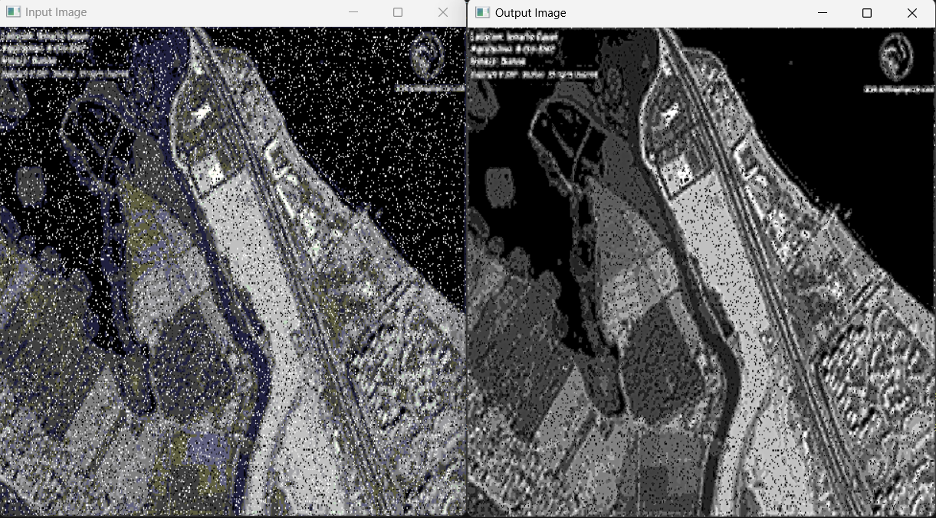

Implementation
Impulsive noise

Slide 23
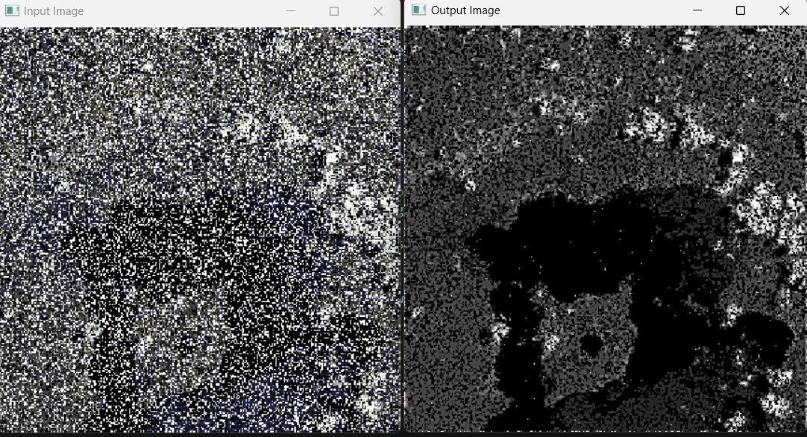

Implementation
Impulsive noise

Slide 24
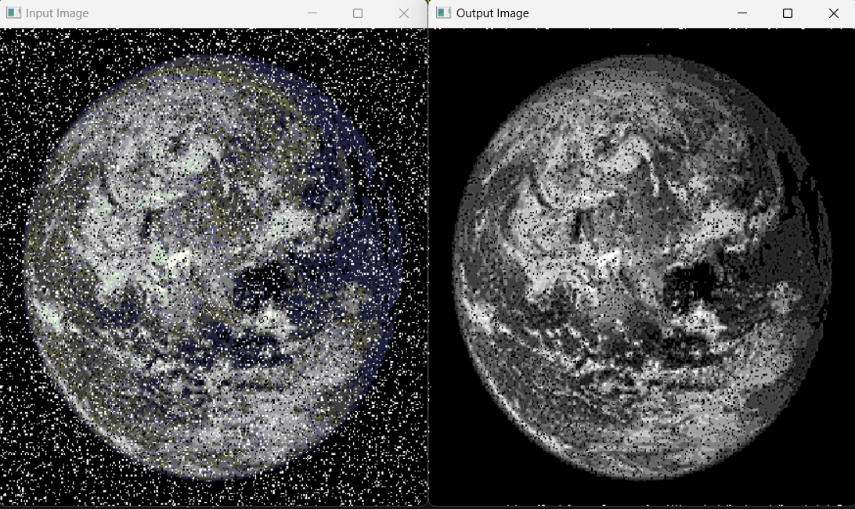

Implementation
Impulsive noise

Slide 25
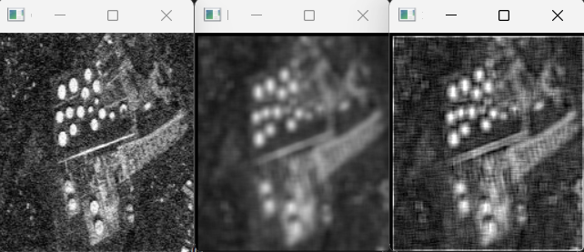
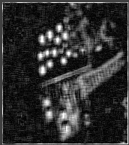

Implementation
Gaussian noise

Slide 26
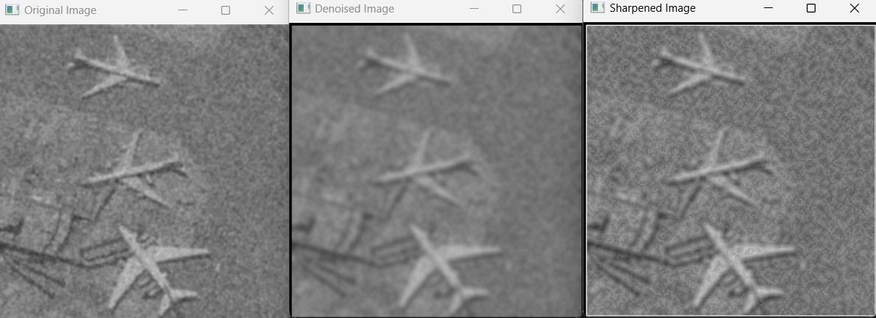

Implementation
Gaussian noise

Slide 27
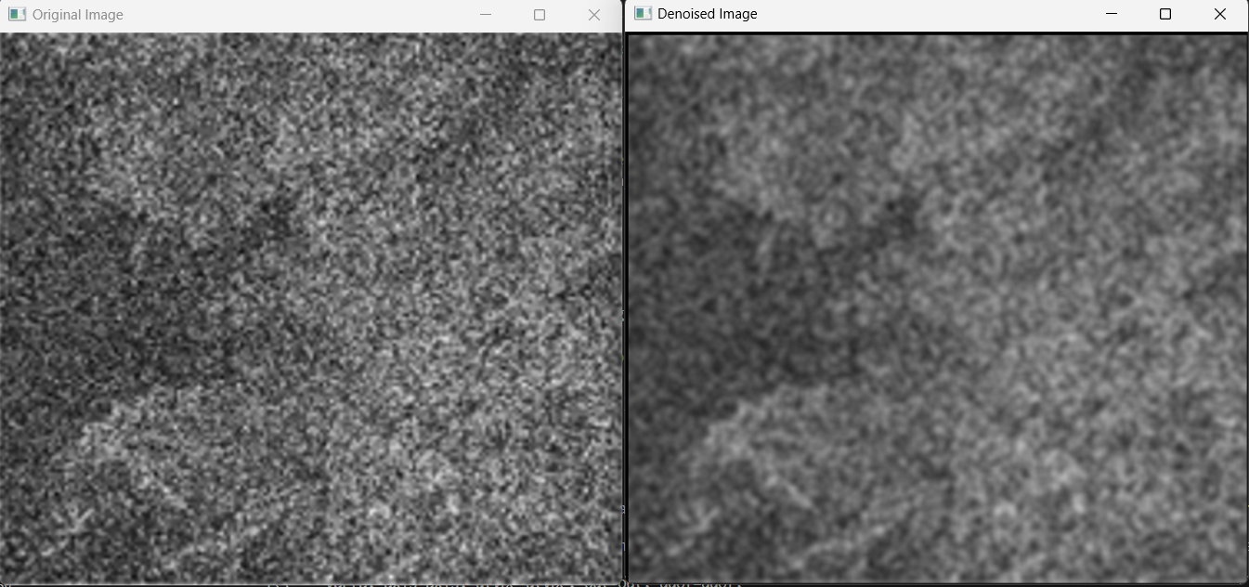
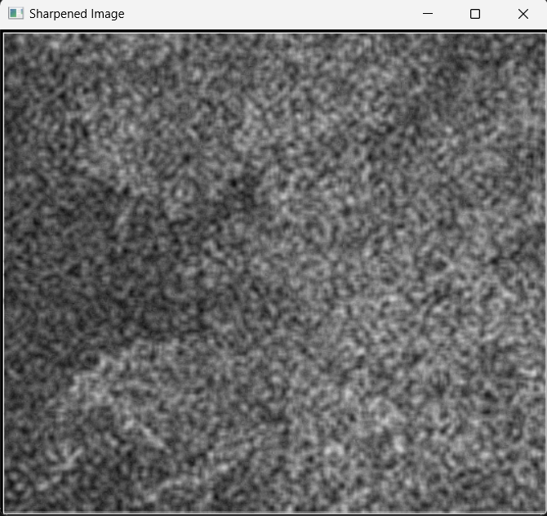

Implementation
Gaussian noise

Slide 28
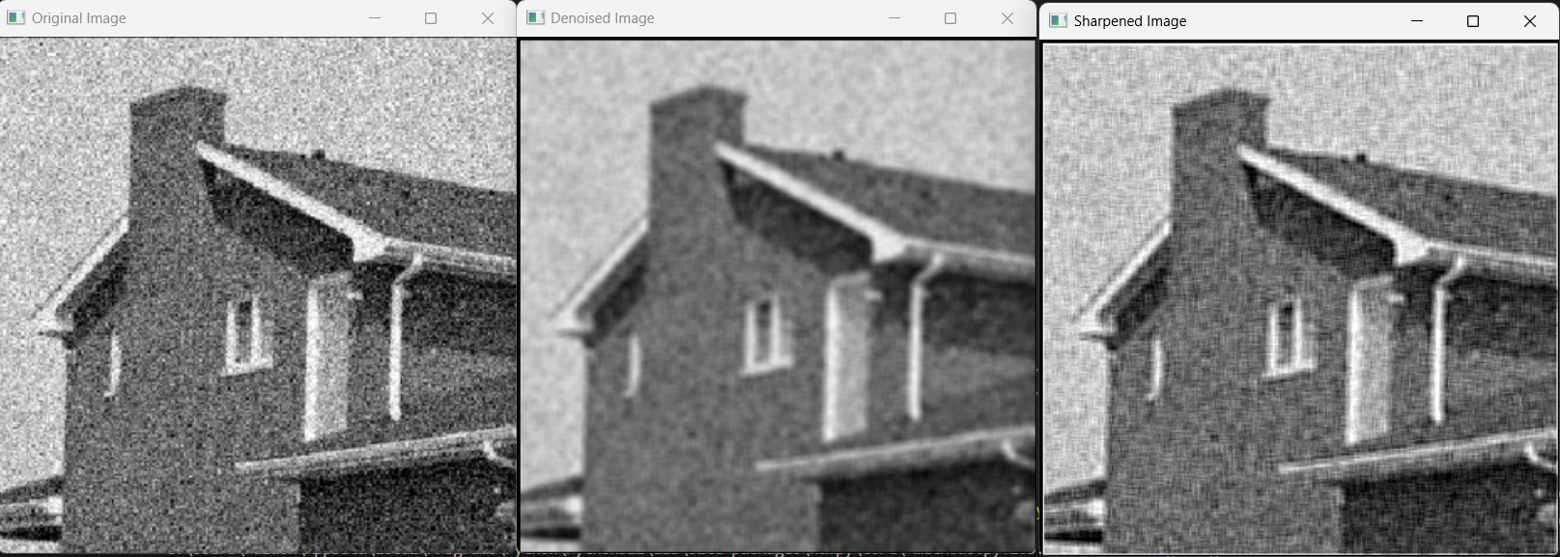
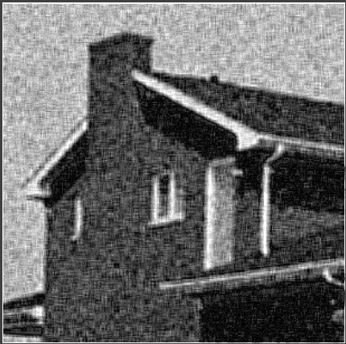
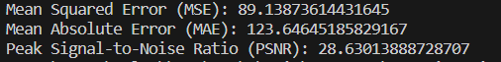
Implementation
Gaussian noise

Slide 29
Status of work to be completed(timeline)

Slide 30
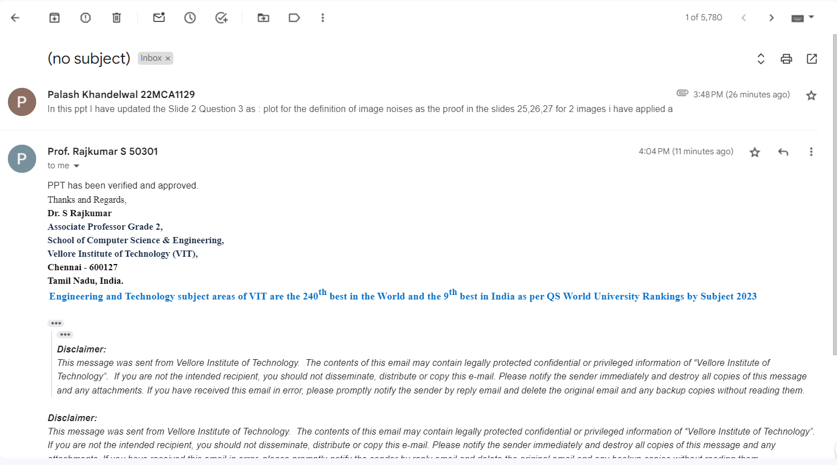
Guide’s Approval Mail Screenshot

Slide 31
References
[1] S. Rajkumar, G. Malathi, "An efficient image denoising approach for the recovery of impulse noise," bulletin of electrical engineering and informatics, vol. 6, no. 3, september 2017, pp. 281-286, ISSN: 2302-9285.
[2] C. Thomasi, R. Manduchi, “Optimization of bilateral filter parameters using a whale optimization algorithm," research in mathematics 2022, vol. 9, no. 1, 2140863
[3] Qiaoyi liang, Runwen Hu And Shijun Xiang " Invertible color-to-grayscale conversion by using clustering and reversible watermarking " (2021, july 5). IEEE conference publication | IEEE xplore. Https://ieeexplore.Ieee.Org/document/9428464
[4] Demudunaidu ch , James Stephen M , Pallam Setty S , Praveen Babu Choppala 4 "A survey of impulse noise reduction methods in digital images ," ISSN- 2394-5125 VOL 7, ISSUE 08, 2020.
[5] Jianbin Xiong, Dezheng Yu , Qi Wang , Lei Shu, Jian Cen, Qiong Liang, Huanyang Chen, and Baocheng Sun “Application of histogram equalization for image enhancement in corrosion areas" volume 2021, article id 8883571, 13 pages https://doi.Org/10.1155/2021/8883571
[6] Bhaskar Jyoti Borah, and Chi-kuang Sun “A gpu-accelerated modified unsharp-masking method for high-frequency background- noise suppression” IEEE access, 9, 68746–68757. Https://doi.Org/10.1109/access.2021.3077287
[7] Snežana Puzović, Ranko Petrović, Miloš Pavlović, Srđan Stanković “Enhancement algorithms for low-light and low- contrast images” 19th international symposium INFOTEH-JAHORINA, 18-20 March 2020
[8] Zhixiang Duan1, Guangxin Li1, Guoliang Fan " An effective sharpness assessment method for shallow depth-of-field images ” (2021, september 19). IEEE conference publication | IEEE xplore. Https://ieeexplore.Ieee.Org/document/9506498
[9] Sergei Yelmanov, Yuriy Romanyshyn " A new approach to image enhancement by non-linear contrast stretching ” (2020, august 1). IEEE conference publication | IEEE xplore. Https://ieeexplore.Ieee.Org/document/9204129
[10] Vedant Gupta, Srikumar Sastry, Suman K. Mitra " Hyperspectral image classification using trilateral filter and deep learning," (2020, december 16. IEEE conference publication | IEEE xplore. Https://ieeexplore.Ieee.Org/document/9358892

